Slide 1
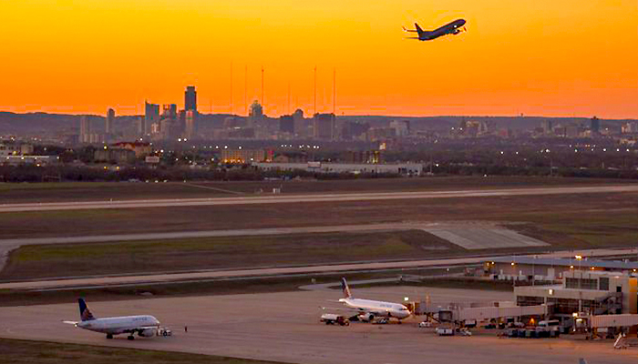
The
The Sky’s The Limit
Charting Growth at Austin-Bergstrom International Airport
A project by Dexter D’Cruz, Mary Gong, Michael Alrafati, and Alan Choate

Slide 2
Documenting growth at ABIA
Austin-Bergstrom International Airport opened on May 23, 1999, on what used to be Bergstrom Air Force Base. Travis County’s population that year was 788,500. By 2017, Travis County had 1.2 million residents, not counting growth in Williamson County to the north and Hays County to the south.
.Austin-Bergstrom International (AUS): In 10 years, the explosive growth of the Austin airport is undeniable. In a trend that is not expected to slow soon, Austin experienced as much as 12 percent growth in the years 2016 and 2017 alone. Though the airport is expanding to try and keep up, the increased domestic routes provided by AUS make facility expansion challenging.
We sought data that would document growth at ABIA as the metro area it serves added more and more people.
For organizational purposes, we limited our data search to 10 years: 2007-2017.

Slide 3
Data Sources
PRIMARY SOURCES
Bureau of Transportation Statistics: www.bts.gov
Available data included fares, passenger counts, and destinations
• City of Austin: data.austintexas.gov
Available data included passenger counts and customer surveys
Supplemental Sources
Census.gov, ABIA website

Slide 4
Questions Asked
How much did passenger volume change?
How much did the average fare change? Is there a relationship between fares and passenger volume?
Did the number of airline serving ABIA change? How much?
Which routes had the most passengers? Did that change over time?
Did the percentage of on-time arrivals and departures change?
Did customer satisfaction with the airport and its services change?

Slide 5
Questions answered … or not
✅ How much did passenger volume change?
✅ How much did the average fare change? Is there a relationship between fares and passenger volume?
X Did the number of airline serving ABIA change? How much? We could not locate a data source to answer this question.
✅ Which routes had the most passengers? Did that change over time?
✅ Did the percentage of on-time arrivals and departures change?

Slide 6
Questions answered … or not (cont’d)
X Did customer satisfaction with the airport and its services change? The city of Austin has a data set with responses to a customer satisfaction survey, but it only has two years of data. We deemed that insufficient for the comparison we sought.

Slide 7
The process
There is quite a bit of public information on airports, airfares, passengers, and other flight-related data. However, most of it was not in a format that fit the questions we asked. So we embarked on a journey of wrangling and winnowing to get the numbers we needed.
For example:
• The city of Austin databases often used timestamps for dates. Separating out the months and years was not technically difficult, but it was tedious.
• The data sets used specialized terminology and abbreviations. The documentation was key to understanding exactly what we had.

Slide 8
The Process (cont’d)
While we wanted data for the 10-year window of 2007-2017, it wasn’t always available. (Austin’s passenger data, for example, only goes back to 2013.) We used what we had when there was enough to show a trend, but in some cases had to abandon the question.
Some data just wasn’t available. For example, we were initially excited to research a fare question: How much of the total fare is the flight, and how much is made up of extras such as baggage fees and the like? That information surely exists somewhere, but we couldn’t find a public data set that has it.

Slide 9
The Process (cont’d)
The heatmap was initially off because the latitude and longitude in the dataset corresponded to the city markets as opposed to specific airports. This resulted in inaccurate heatmap plots in cities with more than one airport. By using Google’s Geocode API the correct airport coordinates were obtained for an accurate map.
Some data needed to be scaled to map accurately. The passenger counts ran into the hundreds of thousands, which resulted in heatmap plots that were ridiculously large. Proportionately reducing those figures made for accurate plots that represented air travel.

Slide 10
AS WE CAN SEE AUSTIN AIRPORT BECAME A SECOND AIRPORT GROWING IN USA.
INCREASED UP TO 62%. DECLINE AND GROWTH ARE BASED ON TOTAL OF NUMBER OF PASSENGERS. AND THE AVERAGE FARE.

